Slide 1
Corporate Social Responsibility (CSR)

Slide 2


Slide 3
INTRODUCTION
The focus is on corporate social responsibility, which involves responsibilities outside of making a profit and the key questions for corporations include:
  Do Companies have a social responsibility?
  If so, what is the extent and type of the responsibility?

Slide 4
What is Corporate Social Responsibility (CSR) :
CSR :“is a management concept where companies integrate social and environmental concerns in their business operations and interactions with their stakeholders”.

Slide 5

  What is Corporate Social Responsibility?
Corporate Social Responsibility
The responsibility of business towards the society

Slide 6
Benefits of CSR
1. Enhance relationships with stakeholders.
2. Access to funding opportunities.
3. Differentiating yourself from the competitors.
4. Saving money on energy and operating cost.
5. Increase in customer retentions.

Slide 7
CSR: Supporting Arguments
1. CSR Explains a commitment to society’s values and contribute to society’s social, environmental, and economic goals through action.
2. CSR Protects society from the negative impacts of company operations, products and services.
3. CSR Demonstrates that the company can make more money by doing the right thing.

Slide 8

Common Corporate Social Responsibility initiative
Actions to protect the environment.
Actions to create a work. environment that enhances employees’ quality of life.
Actions to build a diverse workforce.

Slide 9
Carroll’s Four-Part Definition of CSR
In 1991, Carroll first presented his CSR model as a pyramid. It was suggested that, although the components are not exclusive, it “helps the manager to see that the different types of obligations are in a constant tension with one another”.
Carroll’s model of CSR includes the economic, legal, ethical and discretionary (philanthropic) expectations that society has of organizations at a given point in time.

Slide 10
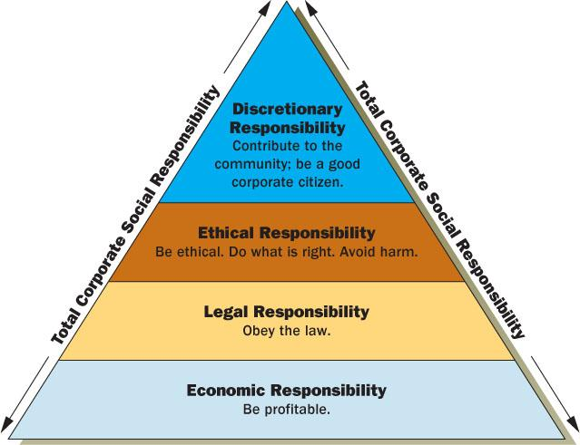

Slide 11
Corporate Social Responsibility (CSR)
Carroll’s Four Part Definition
Understanding the Four Components
Responsibility | Societal Expectation | Examples
Economic | Required | Be profitable. Maximize sales, minimize costs, etc.
Legal | Required | Obey laws and regulations.
Ethical | Expected | Do what is right, fair and just.
Discretionary (Philanthropic) | Desired/ Expected | Be a good corporate citizen.

Slide 12
The CSR Equation
0
Economic Responsibilities
Legal Responsibilities
Ethical Responsibilities
Philanthropic Responsibilities
+
Total
Corporate CSR
=
+
+
Notes:
Chapter 2
Corporate Citizenship:
Social Responsibility, Responsiveness, and Performance

Slide 13
Benefits of CSR for Businesses
Enhanced Brand Reputation: Companies known for their CSR initiatives often enjoy a stronger brand image and increased customer loyalty.
Attraction and Retention of Talent: Employees are more likely to be engaged and committed to organisations that demonstrate social responsibility.

Slide 14
Access to New Markets and Partnerships: CSR can open doors to new business opportunities and collaborations with like-minded organisations.
Alignment with Investor Interests: Investors are increasingly considering Environmental, Social, and Governance (ESG) factors when making decisions.
Risk Mitigation: Proactive CSR practices can help companies anticipate and manage potential social and environmental risks.

Slide 15
CSR Activities
1 Abolishing poverty, malnourishment and hunger, improvising health care which includes preventive health care and sanitation and making available safe drinking water.
2 Improvement in education which includes special education and employment strengthening vocation skills among children, women, elderly and the differently-abled and livelihood enhancement projects.
3 Improving gender equality, setting up homes and hostels for women and orphans.
4 Introducing the measures for reducing inequalities faced by socially and economically backward groups.
5 Safeguarding environmental sustainability, ecological balance, protection of flora and fauna, animal welfare, agroforestry, conservation of natural resources and maintaining a quality of soil, air and water which also includes a contribution for rejuvenation of river Ganga.
6 Protection of national heritage, art and culture including restoration of buildings and sites of historical importance and works of art; setting up public libraries; promotion and development of traditional arts and handicrafts.

Slide 16
7 Areas for the advantage of skilled armed forces, war widows and their dependents.
8 Training to stimulate rural sports, nationally recognized sports, Paralympic sports and Olympic sports.
9 Contribution to the Prime Minister’s National Relief Fund or any other fund set up by the Central Government for socio-economic development providing relief and welfare of the Scheduled Castes, the Scheduled and backward classes, minorities and women.
10 Contributions or funds provided to technology incubators are approved by the Central Government.
11 Rural development projects.
12 Disaster management, including relief, rehabilitation and reconstruction activities.
13 Slum area development where ‘slum area’ shall mean any area declared as such by the Central Government or any State Government or any other competent authority under any law for the time being in force.

Slide 17
Components of CSR
1. Economic Responsibilities:
  Firm has a responsibility to use the resources available to produce goods and services for society.
  Examples: Generating a high and consistent level of profitability, establishing and maintaining a strong competitive position, operating the firm at a high efficiency level.

Slide 18
Components of CSR
2. Legal Responsibilities:
  The laws and regulations that all firms are expected to follow as they perform their daily functions.
  Examples: Operating consistent with government and legal expectations; displaying complete compliance with all regulations.

Slide 19
Components of CSR
3. Ethical Responsibilities:
  Change over time because they are based on expectations of society.
  Examples: Meeting expectations of ethical standards; ability to adapt to new or developing ethical and moral standards; being a good corporate citizen.

Slide 20
Components of CSR
4. Discretionary Responsibilities:
  Those responsibilities in which society does not have a clear message to present to businesses as to what their courses of action should be.
  Left in the hands of managers to make the right judgment.
  Firms are not considered unethical if they do not participate in these discretionary responsibilities
  Examples: giving to charitable organizations; providing drug treatment programs; providing day care centers.

Slide 21
Managers Response to Social Responsibility
There are many ways managers respond to this duty:
Obstructionist response :
- Managers choose not to be socially responsible.
  Managers behave illegally and unethically.
  They hide and cover-up problems.
Defensive response:
- Managers stay within the law but make no attempt to exercise additional social responsibility.
  Put shareholder interest above all other stakeholders.

Slide 22
3. Accommodative response:
- Managers realize the need for social responsibility.
  Try to balance the interests of all stakeholders.
4. Proactive response:
- Managers actively support social responsibility.
  Managers actively help stakeholders.

Slide 23
Levels of Responsibility
Obstruction
response
Defensive
response
Accommodative
response
Proactive
response
Worst
Social responsibility
Best

Slide 24
Challenges in CSR Implementation
Authenticity vs. Performative Activism: Companies must ensure their CSR efforts are genuine and not merely for publicity, as consumers are adept at detecting insincerity.
Alignment with Core Business Strategy: CSR initiatives should be closely integrated with the company's mission and operations to be effective and sustainable.
Measuring Impact: Quantifying the outcomes of CSR activities can be complex, requiring robust metrics and transparent reporting.

